Slide 1
UPPER SIXTH ARTS
GEOGRAPHY
Lesson 1: Sources of Population Data
Sources of Population Data
Notes:
Good morning, class, and welcome to our geography lesson. I am your geography teacher, Mr Kamdem. Today we are starting Lesson 1: Sources of Population Data.

Slide 2
CLASS INFO
Class, Chapter and Duration
Class | Upper Sixth Arts
Chapter | Module 4: Understanding and managing population dynamics across the world in general and Cameroon in particular
Duration | 2 periods (2 × 50 minutes)
Notes:
This lesson is for Upper Sixth Arts. It belongs to Module 4: Understanding and managing population dynamics across the world in general and Cameroon in particular. We shall need 2 periods to cover it.

Slide 3
IDENTIFICATION
Lesson Identification
Topic | Population Numbers
Sub-topic | Population Data
Lesson | Lesson 1: Sources of Population Data
Notions / Concepts | Census, sample survey, vital registration, migration records, demography.
Syllabus focus | Censuses, sample surveys, vital registration and migration records; current state of world population.
Competence | Learners are able to identify sources of population data, judge their reliability and describe the world population today.
Notes:
Our topic is Population Numbers, and the sub-topic is Population Data. The key notions we shall use today are: census, sample survey, vital registration, migration records, demography. At the end, you should be able to do this: learners are able to identify sources of population data, judge their reliability and describe the world population today.

Slide 4

LESSON PLAN
Lesson Plan
Objectives and recall
Real-life situation and action to take
Learning activities
Board summary
Evaluation, remediation and homework
Notes:
Here is the plan of our lesson today. First, we shall look at the objectives and recall what you already know. After that, we shall study a situation from real life and the action to take, and do the learning activities. Finally, we shall copy the board summary, do the evaluation and the remediation, and I will give you the homework.

Slide 5
OBJECTIVES
Objectives
By the end of this lesson, you should be able to:
Name and describe the main sources of population data.
Explain the problems of collecting population data in LEDCs.
Notes:
Take your time to copy this part; we will continue together.

Slide 6
OBJECTIVES
Objectives (continued)
Describe the current state of world population.
Notes:
By the end of this lesson, you should be able to do three things. Number 1: name and describe the main sources of population data. Number 2: explain the problems of collecting population data in LEDCs. Number 3: describe the current state of world population.

Slide 7
PREVIOUS KNOWLEDGE
Previous Knowledge
Population geography studies people in space.
Cameroon held censuses in 1976, 1987 and 2005.
Notes:
Let us first remember what you already know. Population geography studies people in space. Cameroon held censuses in 1976, 1987 and 2005. Keep this in mind, because we shall build on it today.

Slide 8
REAL-LIFE SITUATION
Situation in Real Life
The Ministry of Health must decide how many schools and health centres to build in the Far North. An official says, "We cannot plan without good numbers." The last full census was many years ago.
Notes:
Listen carefully to this situation from real life. The Ministry of Health must decide how many schools and health centres to build in the Far North. An official says, "We cannot plan without good numbers." The last full census was many years ago. Think about it, because I am going to ask you some questions.

Slide 9
REAL-LIFE SITUATION
Situation: Question 1
What is the problem in the situation?
Notes:
Question 1: What is the problem in the situation? Think for a moment, then raise your hand to answer.

Slide 10
REAL-LIFE SITUATION
Answer
Planners need reliable population figures.
Notes:
Good. Planners need reliable population figures.

Slide 11
REAL-LIFE SITUATION
Situation: Question 2
Where can they find population figures?
Notes:
Question 2: Where can they find population figures? Think for a moment, then raise your hand to answer.

Slide 12
REAL-LIFE SITUATION
Answer
In censuses, surveys and registers of births and deaths.
Notes:
Good. In censuses, surveys and registers of births and deaths.

Slide 13
REAL-LIFE SITUATION
Situation: Question 3
Why are old figures a problem?
Notes:
Question 3: Why are old figures a problem? Think for a moment, then raise your hand to answer.

Slide 14
REAL-LIFE SITUATION
Possible Answer
The population has grown and moved since then.
Notes:
Good. The population has grown and moved since then.

Slide 15
ACTION TO TAKE
Action to Take
Register births and deaths and take part in censuses so that planning is based on good data.
Notes:
From this situation, the action we are working towards in this lesson is the following: register births and deaths and take part in censuses so that planning is based on good data.

Slide 16
JUSTIFICATION
Justification of the Lesson
This lesson helps us to know where population figures come from and how reliable they are.
Notes:
Why is this lesson important for you? This lesson helps us to know where population figures come from and how reliable they are.

Slide 17
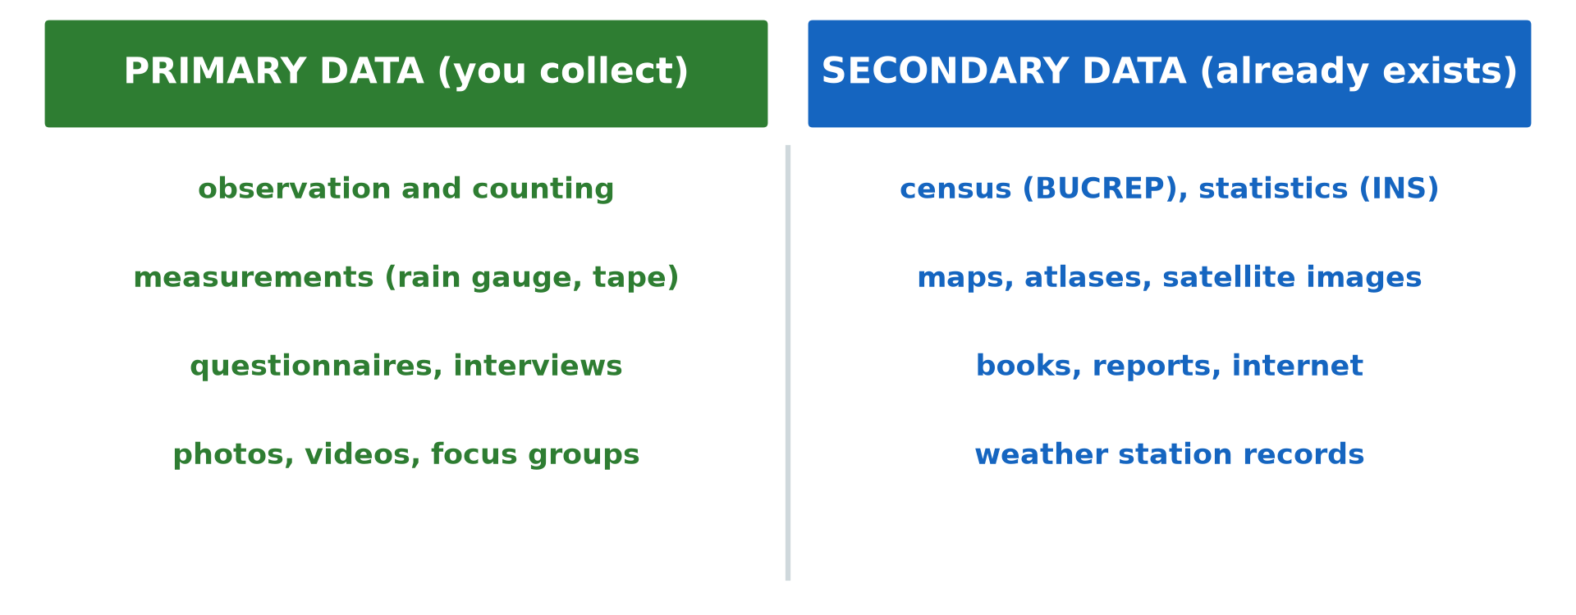
1. A) CENSUSES
Activity 1
The four main sources of population data.
Notes:
Activity 1. Look carefully at this diagram: the four main sources of population data. Observe every detail before I ask the question.

Slide 18
1. A) CENSUSES
Activity 1: Question
Which source counts every person in the country at one time?
Notes:
Here is the question for Activity 1: Which source counts every person in the country at one time? Take one minute to think and write your answer in your rough notebook.

Slide 19
1. A) CENSUSES
Activity 1: Answer
The census.
Notes:
Let us check the answer together. The census.

Slide 20
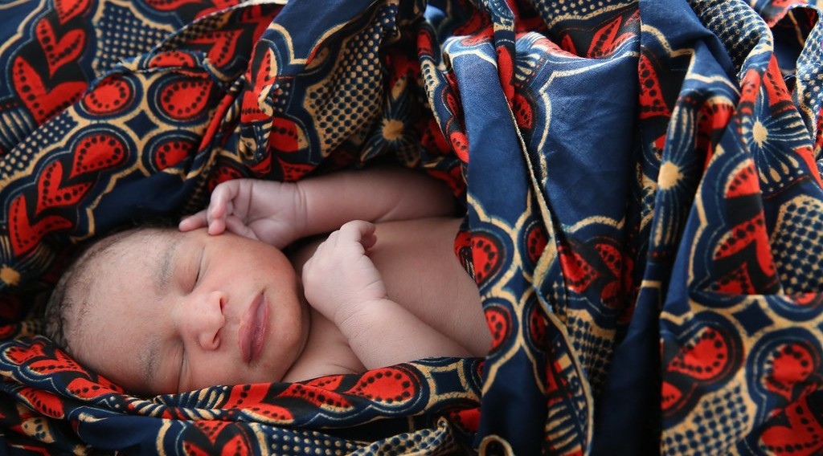
1. C) VITAL REGISTRATION
Activity 2
A newborn baby.
Notes:
Activity 2. Look carefully at this picture: a newborn baby. Observe every detail before I ask the question.

Slide 21
1. C) VITAL REGISTRATION
Activity 2: Question
Which source records births and deaths as they happen?
Notes:
Here is the question for Activity 2: Which source records births and deaths as they happen? Take one minute to think and write your answer in your rough notebook.

Slide 22
1. C) VITAL REGISTRATION
Activity 2: Answer
Vital registration (civil status registers).
Notes:
Let us check the answer together. Vital registration (civil status registers).

Slide 23
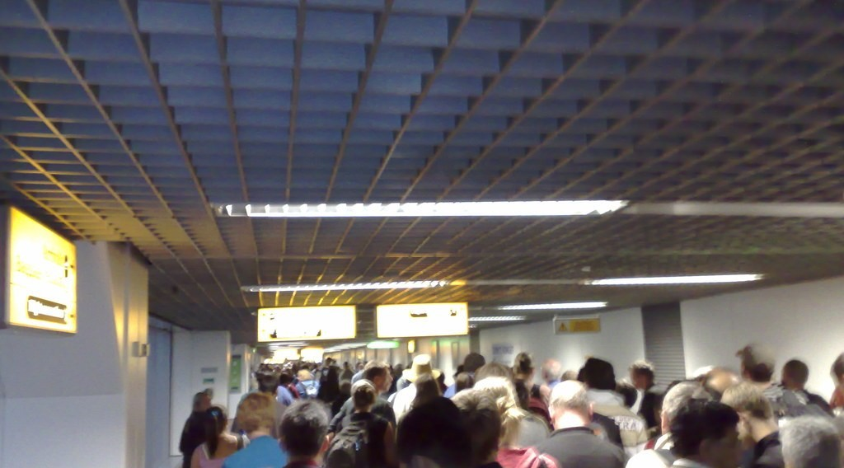
1. D) MIGRATION RECORDS
Activity 3
Travellers arriving at an airport (London).
Notes:
Activity 3. Look carefully at this picture: travellers arriving at an airport (London). Observe every detail before I ask the question.

Slide 24
1. D) MIGRATION RECORDS
Activity 3: Question
Which source records people entering and leaving a country?
Notes:
Here is the question for Activity 3: Which source records people entering and leaving a country? Take one minute to think and write your answer in your rough notebook.

Slide 25
1. D) MIGRATION RECORDS
Activity 3: Answer
Migration records (passports, visas, border counts).
Notes:
Let us check the answer together. Migration records (passports, visas, border counts).

Slide 26

1. A) PROBLEMS OF CENSUSES
Activity 4
School children in rural Africa.
Notes:
Activity 4. Look carefully at this picture: school children in rural Africa. Observe every detail before I ask the question.

Slide 27
1. A) PROBLEMS OF CENSUSES
Activity 4: Question
Give two problems of taking a census in LEDCs.
Notes:
Here is the question for Activity 4: Give two problems of taking a census in LEDCs. Take one minute to think and write your answer in your rough notebook.

Slide 28
1. A) PROBLEMS OF CENSUSES
Activity 4: Answer
Cost, poor roads, illiteracy, nomads and people who hide from counting.
Notes:
Let us check the answer together. Cost, poor roads, illiteracy, nomads and people who hide from counting.

Slide 29
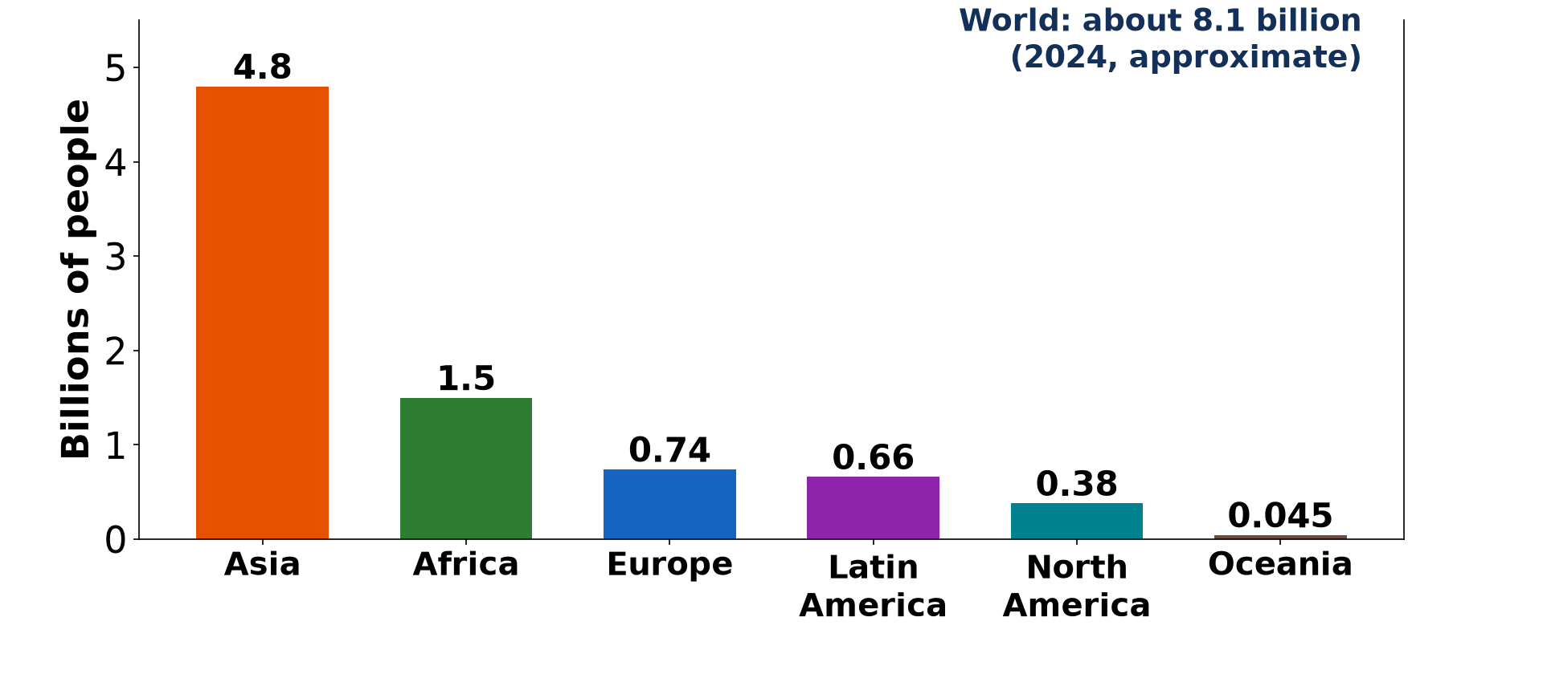
2. CURRENT STATE OF GLOBAL POPULATION
Activity 5
World population by continent (2024, approximate).
Notes:
Activity 5. Look carefully at this diagram: world population by continent (2024, approximate). Observe every detail before I ask the question.

Slide 30
2. CURRENT STATE OF GLOBAL POPULATION
Activity 5: Question
Which continent has the most people? About how many people live on Earth?
Notes:
Here is the question for Activity 5: Which continent has the most people? About how many people live on Earth? Take one minute to think and write your answer in your rough notebook.

Slide 31
2. CURRENT STATE OF GLOBAL POPULATION
Activity 5: Answer
Asia; about 8.1 billion.
Notes:
Let us check the answer together. Asia; about 8.1 billion.

Slide 32
BOARD SUMMARY
Board Summary
Topic: Population Numbers
Sub-topic: Population Data
Lesson 1: Sources of Population Data
Notes:
Now we are going to copy the board summary. Write the title and the headings neatly in your notebooks. I will give you enough time for each slide, so do not rush.

Slide 33
BOARD SUMMARY
DEFINITIONS
The key terms of this lesson are defined as follows:
Population data: They are figures on the number, structure and movement of people.
Census: It is the official count of all the people of a country at a given time.
Notes:
Let us copy the definitions. The key terms of this lesson are defined as follows. On this slide we have Population data and Census. Write each point on a new line, with the key term first, and explain it in your own words when we revise.

Slide 34
BOARD SUMMARY
1. Sources of Population Data
Population data come from the following sources:
Censuses: A census counts every person and records age, sex, occupation and residence, usually every ten years. Cameroon held censuses in 1976, 1987 and 2005 (BUCREP).
Notes:
Let us copy Sources of Population Data. Population data come from the following sources. On this slide we have Censuses. Write each point on a new line, with the key term first, and explain it in your own words when we revise. When you finish, we go to the next slide.

Slide 35
BOARD SUMMARY
1. Sources of Population Data (continued)
Sample surveys: They collect detailed information from a small part of the population, such as the Demographic and Health Surveys. They are cheaper and faster than a census.
Notes:
We continue with Sources of Population Data. On this slide we have Sample surveys. Write each point on a new line, with the key term first, and explain it in your own words when we revise. When you finish, we go to the next slide.

Slide 36
BOARD SUMMARY
1. Sources of Population Data (continued)
Vital registration: It records births, deaths and marriages as they happen at the civil status office. It gives birth and death rates between censuses.
Notes:
We continue with Sources of Population Data. On this slide we have Vital registration. Write each point on a new line, with the key term first, and explain it in your own words when we revise. When you finish, we go to the next slide.

Slide 37
BOARD SUMMARY
1. Sources of Population Data (continued)
Migration records: Passports, visas, border and refugee records show people entering and leaving a country. Many movements across African borders are not recorded.
Notes:
We continue with Sources of Population Data. On this slide we have Migration records. Write each point on a new line, with the key term first, and explain it in your own words when we revise.

Slide 38
BOARD SUMMARY
1. Sources of Population Data
Illustration: sources of population data
Notes:
Now draw this illustration in your notebook: sources of population data. Give it a title and label it clearly.

Slide 39
BOARD SUMMARY
1. Sources of Population Data
Problems of Data Collection in LEDCs
Data collection faces the following problems:
Practical problems: Poor roads, remote villages, nomads and insecurity make counting difficult. Many births and deaths are never registered.
Notes:
Let us copy Problems of Data Collection in LEDCs. Data collection faces the following problems. On this slide we have Practical problems. Write each point on a new line, with the key term first, and explain it in your own words when we revise. When you finish, we go to the next slide.

Slide 40
BOARD SUMMARY
1. Sources of Population Data
Problems of Data Collection in LEDCs (continued)
Financial and social problems: Censuses are very expensive, and illiteracy and mistrust lead to wrong answers. Data may be manipulated for political reasons.
Notes:
We continue with Problems of Data Collection in LEDCs. On this slide we have Financial and social problems. Write each point on a new line, with the key term first, and explain it in your own words when we revise.

Slide 41
BOARD SUMMARY
2. Current State of Global Population
The world population today can be described as follows:
World total: The world population passed 8 billion in 2022 and grows by about 70 million a year. Growth is slowing down.
Notes:
Let us copy Current State of Global Population. The world population today can be described as follows. On this slide we have World total. Write each point on a new line, with the key term first, and explain it in your own words when we revise. When you finish, we go to the next slide.

Slide 42
BOARD SUMMARY
2. Current State of Global Population (continued)
Distribution: Asia has about 60 % of the world population, with China and India above 1.4 billion each. Africa has the fastest growth and the youngest population.
Notes:
We continue with Current State of Global Population. On this slide we have Distribution. Write each point on a new line, with the key term first, and explain it in your own words when we revise.

Slide 43
BOARD SUMMARY
2. Current State of Global Population
Illustration: world population by continent
Notes:
Now draw this illustration in your notebook: world population by continent. Give it a title and label it clearly.

Slide 44
FORMATIVE EVALUATION
Evaluation 1
Distinguish a census and a sample survey.
Notes:
Now let us check what you have understood. Question 1: Distinguish a census and a sample survey. Answer in your exercise book.

Slide 45
FORMATIVE EVALUATION
Expected Answer
A census counts everyone; a sample survey studies only a part of the population.
Notes:
The expected answer is: a census counts everyone; a sample survey studies only a part of the population. If you got it right, well done.

Slide 46
FORMATIVE EVALUATION
Evaluation 2
Give two problems of population data in LEDCs.
Notes:
Now let us check what you have understood. Question 2: Give two problems of population data in LEDCs. Answer in your exercise book.

Slide 47
FORMATIVE EVALUATION
Expected Answer
Poor roads and illiteracy (also cost, insecurity, nomads, unregistered births).
Notes:
The expected answer is: poor roads and illiteracy (also cost, insecurity, nomads, unregistered births). If you got it right, well done.

Slide 48
REMEDIATION
Remediation
Fill in the blanks:
An official count of all people is a ______.
Births and deaths are recorded by vital ______.
The continent with most people is ______.
Notes:
For those who need more practice, fill in the blanks in your exercise book. The answers are: number 1, census; number 2, registration; number 3, Asia.

Slide 49
HOMEWORK
Homework
Ask five adults if they have a birth certificate and explain why some do not.
Notes:
For your homework: Ask five adults if they have a birth certificate and explain why some do not. We shall correct it at the beginning of our next lesson.

Slide 50
NEXT LESSON
Next Lesson
Our next lesson will be on:
Lesson 2: Population Distribution and Density
Notes:
Our next lesson will be on Lesson 2: Population Distribution and Density. Thank you for your attention, and see you next time.

Slide 51
BILINGUAL GAME
Bilingual Game (Jeu Bilingue)
English | Français
Census | Le recensement
Survey | L'enquête
Birth certificate | L'acte de naissance
Data | Les données
Migration | La migration
Demography | La démographie
Notes:
Let us play the bilingual game. I say a word in English, and you give me the French word. Then we do the reverse.

Slide 52
LOGBOOK
Official Logbook (1/2)
Module / Topic | Population Numbers
Lesson Title | Lesson 1: Sources of Population Data
Expected Learning Outcomes | Name and describe the main sources of population data. Explain the problems of collecting population data in LEDCs. Describe the current state of world population.
Competence | Learners are able to identify sources of population data, judge their reliability and describe the world population today.
Notes:
I record this information in the official logbook of the class after the lesson.

Slide 53
LOGBOOK
Official Logbook (2/2)
Matter Taught | DEFINITIONS; Sources of Population Data; Problems of Data Collection in LEDCs; Current State of Global Population.
Evaluation | Formative evaluation and remediation exercise.
Homework | Ask five adults if they have a birth certificate and explain why some do not.
Enrolment / Present / Absent | ____ / ____ / ____
Achievement | To be completed after the lesson.
Notes:
I complete the second page of the logbook: the matter taught, the evaluation, the homework and the attendance.

Slide 54
TEACHER'S NOTE
Teacher's Note
Timing: Homework correction, plan, objectives 8 min | Recall, situation, action 10 min | 5 activities 30 min | Board summary (copying) 30 min | Evaluation, remediation 10 min | Homework, next lesson 5 min | Logbook 7 min
Without the projector (Activity 1): list the four sources on the board.
Without the projector (Activity 2): ask who has a birth certificate.
Without the projector (Activity 3): describe a border post.
Without the projector (Activity 4): discuss difficulties in remote villages.
Without the projector (Activity 5): draw the bars.
Notes:
This slide is for me, the teacher: it gives the timing of the lesson and what to do if the projector is not available.

Slide 55
REFERENCES
References
National Geography Syllabus, MINESEC/IGE/IP-SS, 2019 — Module 4 (Population Geography).
Photo, Activity 2: “Newborn baby rests” by World Bank Photo Collection, CC BY-NC-ND 2.0, via Flickr (https://www.flickr.com/photos/10816734@N03/19845580540)
Photo, Activity 3: “London Heathrow T4 arrivals” by markhillary, CC BY 2.0, via Flickr (https://www.flickr.com/photos/56087830@N00/1568955656)
Photo, Activity 4: “African school children” by World Resources, CC BY-NC-SA 2.0, via Flickr (https://www.flickr.com/photos/26107309@N05/2658469563)
Diagrams and animations: drawn for this lesson (Geography Department).
Notes:
These are the references and picture credits used to prepare this lesson.

